Slide 1

Preparing children for the transition to school and school Readiness

Slide 2

Pathway to School
Starting school is an exciting step for your child and your family.
It is normal for children and parents/carers to feel excited and anxious about starting school as it is the first big change for them away from you.
Staying relaxed and calm will support your child to feel less anxious about school and you can help a lot by talking together with your child to help them understand what to expect when starting school.

Slide 3
In the months leading up to school…
Talk about the fun things that will happen at school e.g. playing with friends, painting, story time.
Share photos from the school’s website to help your child become familiar with the school.
Practise the school routine such as trying on uniform, travelling to school – supporting your child to dress and undress independently.
Read books together about school – you could visit your local library to find books here too.
Ensure your child is using the toilet independently and washing their hands afterwards.
Attend any transition days school has on so your child is familiar with the school, staff and peers.

Slide 4
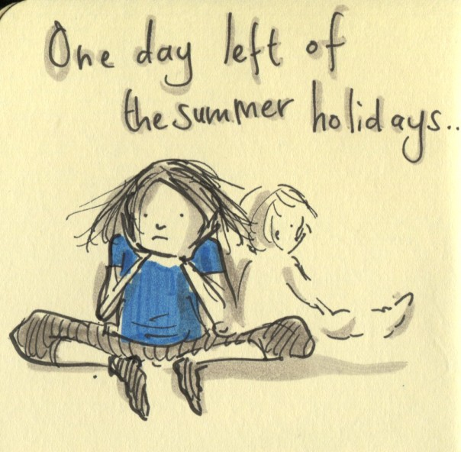

The night before school
Get everything ready – check all clothes and possessions are labelled with your child’s name. Ask your child to help you lay out their clothes ready for the next day.
Talk about going to school – remind your child about what will happen, what they will do and that however they are feeling is okay. Talk about this together and say “I know you feel a bit worries and this is OK, I get worried too”. Ruby’s worry is a brilliant story to discuss worries together.
Get an early night – Make sure your child gets lots of rest ready for the big day ahead.

Slide 5
The first day of school
Breakfast – Eat a healthy breakfast to help your child concentrate at school.
Leave plenty of time – Plan extra time so you have plenty of time to get ready as you do not want to rush and cause any upset. This way you can get to school nice and early and by more relaxed and ready to start the day.
Take a photo – A lovely way to remember the first day of school.
Say goodbye and reassure your child – Tell them who is collecting them and that it will not be long. Make sure you do not simply sneak away and have said bye as this can sometimes cause more upset. You could leave a little message in your child's bag or draw matching pictures on your hand and their hands.
Asking for help – remind your child to ask for help from a teacher of friend if they are upset, worried or unsure of something.

Slide 6
After school
Be prepared for a tired child – a school day is exhausting for a start so be prepared for a tired child.
Check their book bag –there may be letters or possibly some school work your child has completed.
Talk with your child – how was their day at school? Who did they play with? What have they enjoyed?
Continue to establish a routine – have tea, bath, enjoy a story together and get ready for bed.

Slide 7
Being ‘School ready’
Support your child to:
Have a go at new things and keep trying even when they are difficult.
Make their own choices and follow routines
Know about their feelings and naming them.
Get help from others when they need it
Follow simple instructions
Listen and take turns when talking.
Join in with songs, rhymes and stories.
Use a knife and fork correctly.
Use scissors and a paintbrush correctly.
Make marks using pens and paper – drawings or sometimes the letters of their name.
Use the toilet independently and wash their hands after too.
These are all important skills to give your child the best start in Reception.

Slide 8
Concerns
If you have any concerns or questions about being school ready then please:
Contact the school
Talk to a health professional such as your GP or Health Visitor.
Discuss your concerns with your child's nursery, pre-school, childminder or school.
Visit the Local Offer website.

Slide 9
Thank you

