Slide 1
Teach reading:change lives
Parent workshop: Phonics and early reading in Reception
Autumn 1

Slide 2
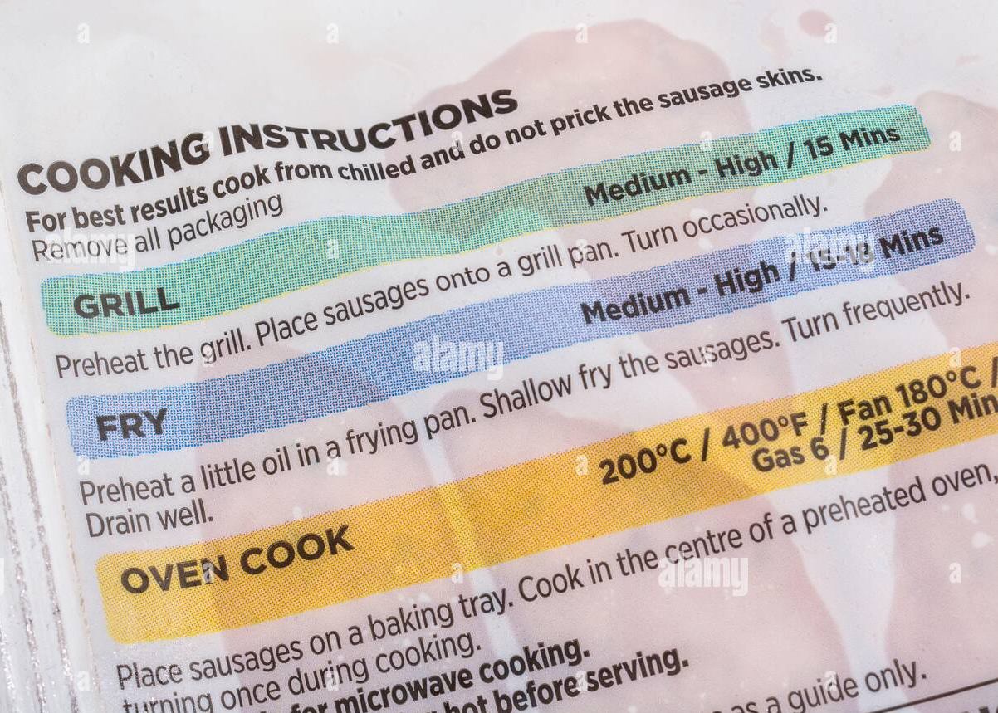
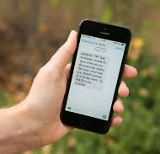
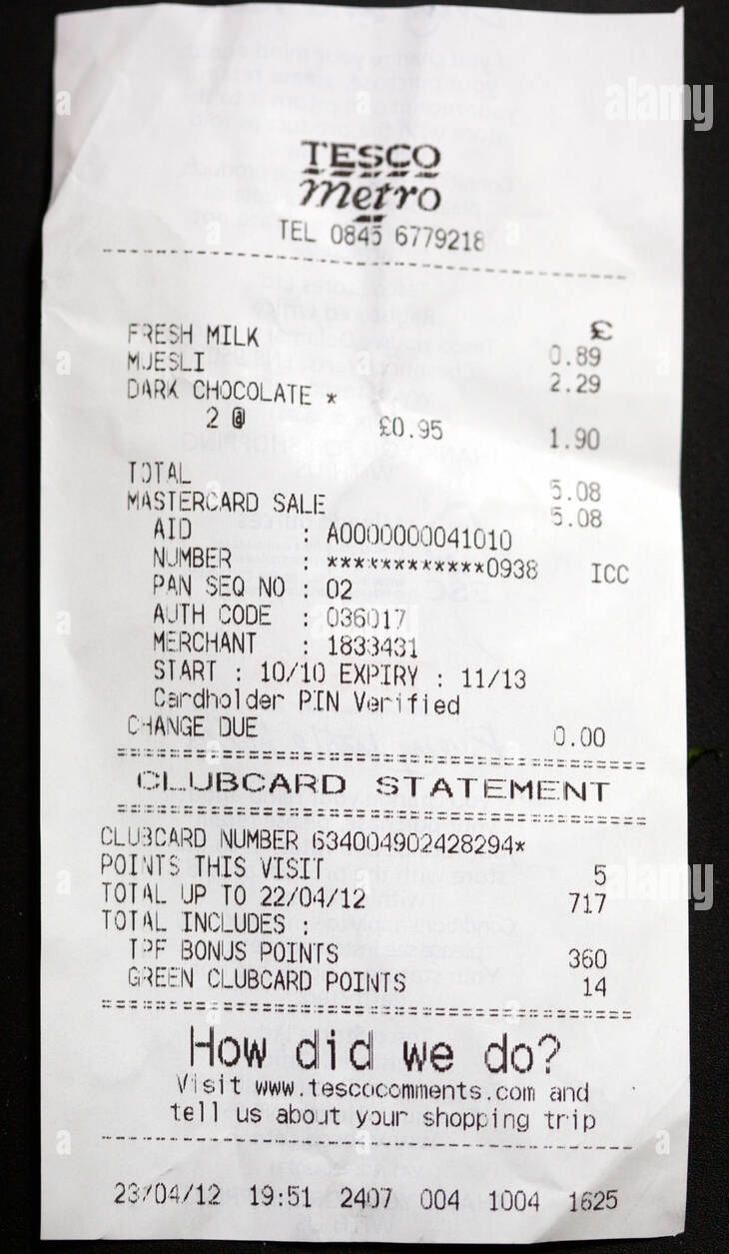
How many times have you read today?

Slide 3
Phonics

Slide 4
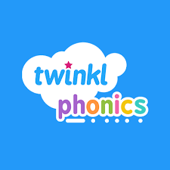
Our school has chosen the accredited Twinkl Phonics programme to teach early reading and spelling.
Phonics is:
Making connections between the sounds of our spoken words and the letters that are used to write them down.

Slide 5
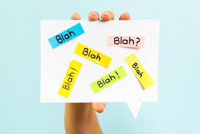
Phonic Jargon Buster

Slide 6
Phoneme
A phoneme is the smallest unit of sound within a word. For example, in the word ‘cat’, there are three phonemes: /c/ /a/ /t/. Phonemes can be represented by more than one letter, for example, in the word ‘buzz’, there are three phonemes: /b/ /u/ /zz/.
This Photo by Unknown Author is licensed under CC BY-SA

Slide 7
Grapheme
A grapheme is a written representation of a phoneme (a unit of sound). Graphemes can be one, two, three or four letters long. For example, ‘a’ is a grapheme in ‘can’, ‘ai’ is a grapheme in ‘rain’, ‘igh’ is a grapheme in ‘sigh’ and ‘eigh’ is a grapheme in ‘eight’.

Slide 8
Digraph and Trigraph
A digraph is a grapheme that is made up using two letters to represent one phoneme (sound). For example, the phoneme /ch/ is represented by two letters.
A trigraph is a grapheme that is made up of three letters to represent one phoneme. For example, the phoneme /igh/ is represented by three letters.

Slide 9
CVC words
CVC stands for consonant-vowel-consonant and is used to describe words with this letter formation, such as ‘pig’, ‘net’ and ‘map’.

Slide 10
Blending
Blending is merging the individual sounds in a word together in order to read the whole word. For example, we can blend the sounds /f/ /i/ /sh/ to make the word ‘fish’
i
f
sh

Slide 11
Segmenting
Segmenting is a skill used in writing and spelling. It means breaking down a word into its individual sounds to be able to then write those sounds down in the correct order. Children are sometimes taught to count the phonemes (individual sounds) they can hear in a word to help them to make sure they represent each sound when attempting to write it.
sh
f
i

Slide 12
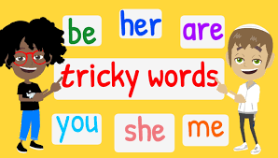
Tricky words
Tricky words are words that your child will not be able to sound out using their knowledge of phonics so far. They are also called common exception words. As your child learns more and progresses through the phonics phases, tricky words will no longer be tricky as your child will have the skills to decode them.

Slide 13
What is taught and when?
This term we are teaching Level 2. These are the first group of letters and sounds your child will learn.
• We start teaching from week 2 of Reception.
• The lessons are fun, interactive, engaging and have been designed to gradually build over time.
Twinkl Phonics Level | Number of Teaching Weeks | Recommended Year Group (UK schools) | Age of Children
Level 1 | 36 | Nursery/Preschool | 3-4 years
Level 2 | 7 | Reception | 4-5 years
Level 3 | 12 | Reception | 4-5 years
Level 4 | 5 | Reception | 4-5 years
Level 5 | 30 | Year 1 | 5-6 years
Level 6 | 30 | Year 2 | 6-7 years

Slide 14
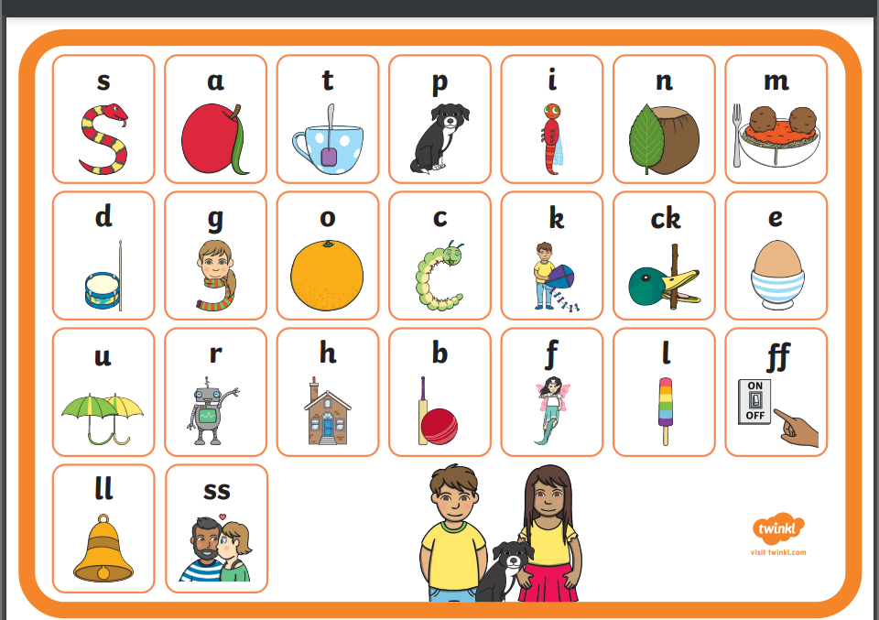
Let’s say the Level 2 sounds

Slide 15
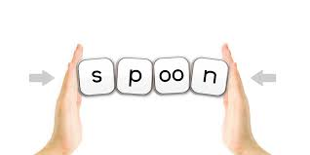
We teach blending so your child learns to read
Teacher-led blending is taught throughout Level 2.
Our aim to is to teach every child to blend by Christmas.
We will inform you if your child needs additional practice.

Slide 16
Spelling
Your child will be taught how to spell simple words, using the graphemes they have been taught.
Robot Rick will help them:
Say the word.
• Segment the sounds.
• Count the sounds.
• Write them down.

Slide 17
Handwriting
They will practise daily the correct formation of letters using our mnemonic phrases and pictures for support.

Slide 18
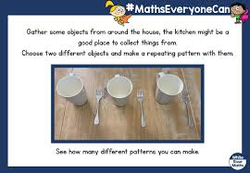
Homework
Reading
Maths
Phonics

Slide 19
Reading day
Your child will have been given a special day that they will need to return their old book and receive a new one. On this day, the teacher or LSA will read and discuss the book and review any sounds and tricky words that have been previously learnt. The book will not be changed if it is not handed in on this day.
Please record in your child’s diary if you have read with them. This is important as it is your chance to communicate with us and share how your child got on with the book. A short message is fine.
PLEASE READ AT LEAST FOUR TIMES A WEEK.

Slide 20
Listening to your child read their decodable book
Your child should be able to read most of their book without your help.
They might sound out words and blend them before they read them fluently.
If they can’t read a word, read it to them.
Talk about the book and celebrate their success.

Slide 21
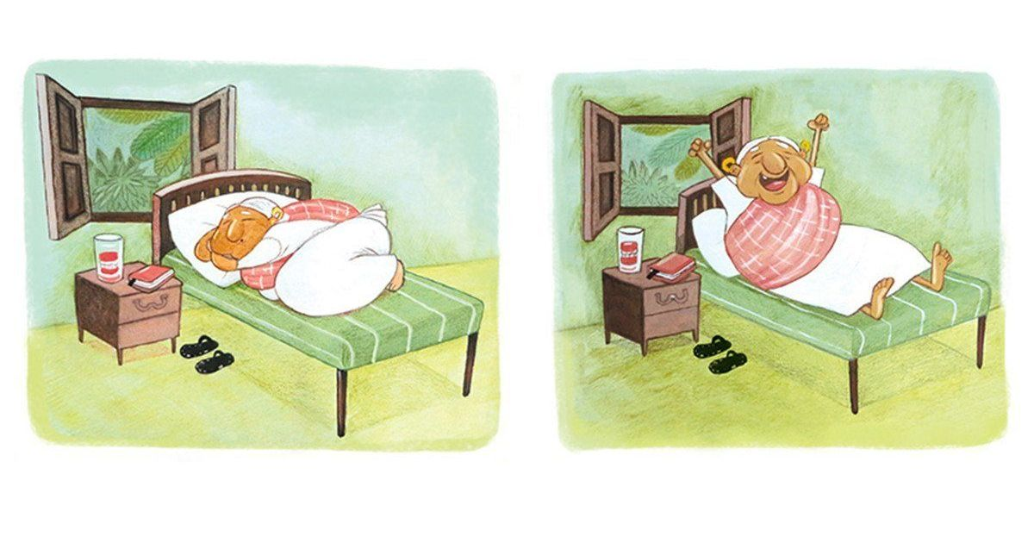
Reading a wordless book
Wordless books are invaluable as they teach reading behaviours and early reading skills to children who are not blending – yet!
• Talk about the pictures.
• Point to the images in the circles and find them on the page.
• Encourage your child to make links from the book to their experiences.

Slide 22
Read to your child
The shared book is for YOU to read:
• Make the story sound as exciting as you can by changing your voice.
• Talk with your child as much as you can:
Introduce new and exciting language.
Encourage your child to use new vocabulary.
Make up sentences together.
Find different words to use.
Describe things you see.

Slide 23
Phonics
Progression of Skills
Twinkl phonics cover all the essential phonics skills.
From grapheme recognition to segmenting, each Level has its own unique combination of games that are focused on the different skills, graphemes and tricky words taught within each Level.

Slide 24
How to access Twinkl phonics at home
https://www.twinkl.co.uk/learn

