Slide 1
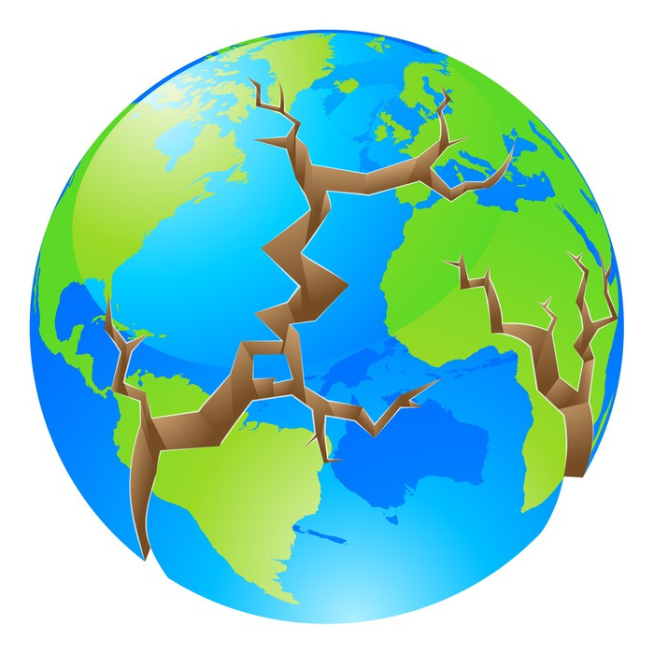
The world is in
DANGER

Slide 2
contents
Page
number
How does the world get hotter 3
What is climate change 4
The effects of climate change 5
What can we do to help 6
The rainforests 7

Slide 3
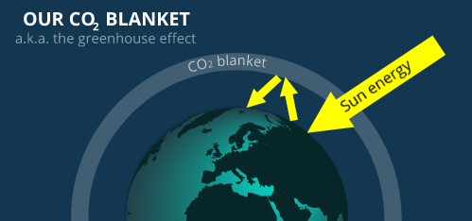
HOW DOES THE WORLD GET HOTTER?
The world gets hotter by a imaginary blanket that is around the world. And every time we let pollution into the air the blanket will get bigger. And every time it gets bigger it makes the world more hotter. So every time it gets hotter it makes the ice bergs melt so more and more animals are dying because of the big blanket.
3

Slide 4
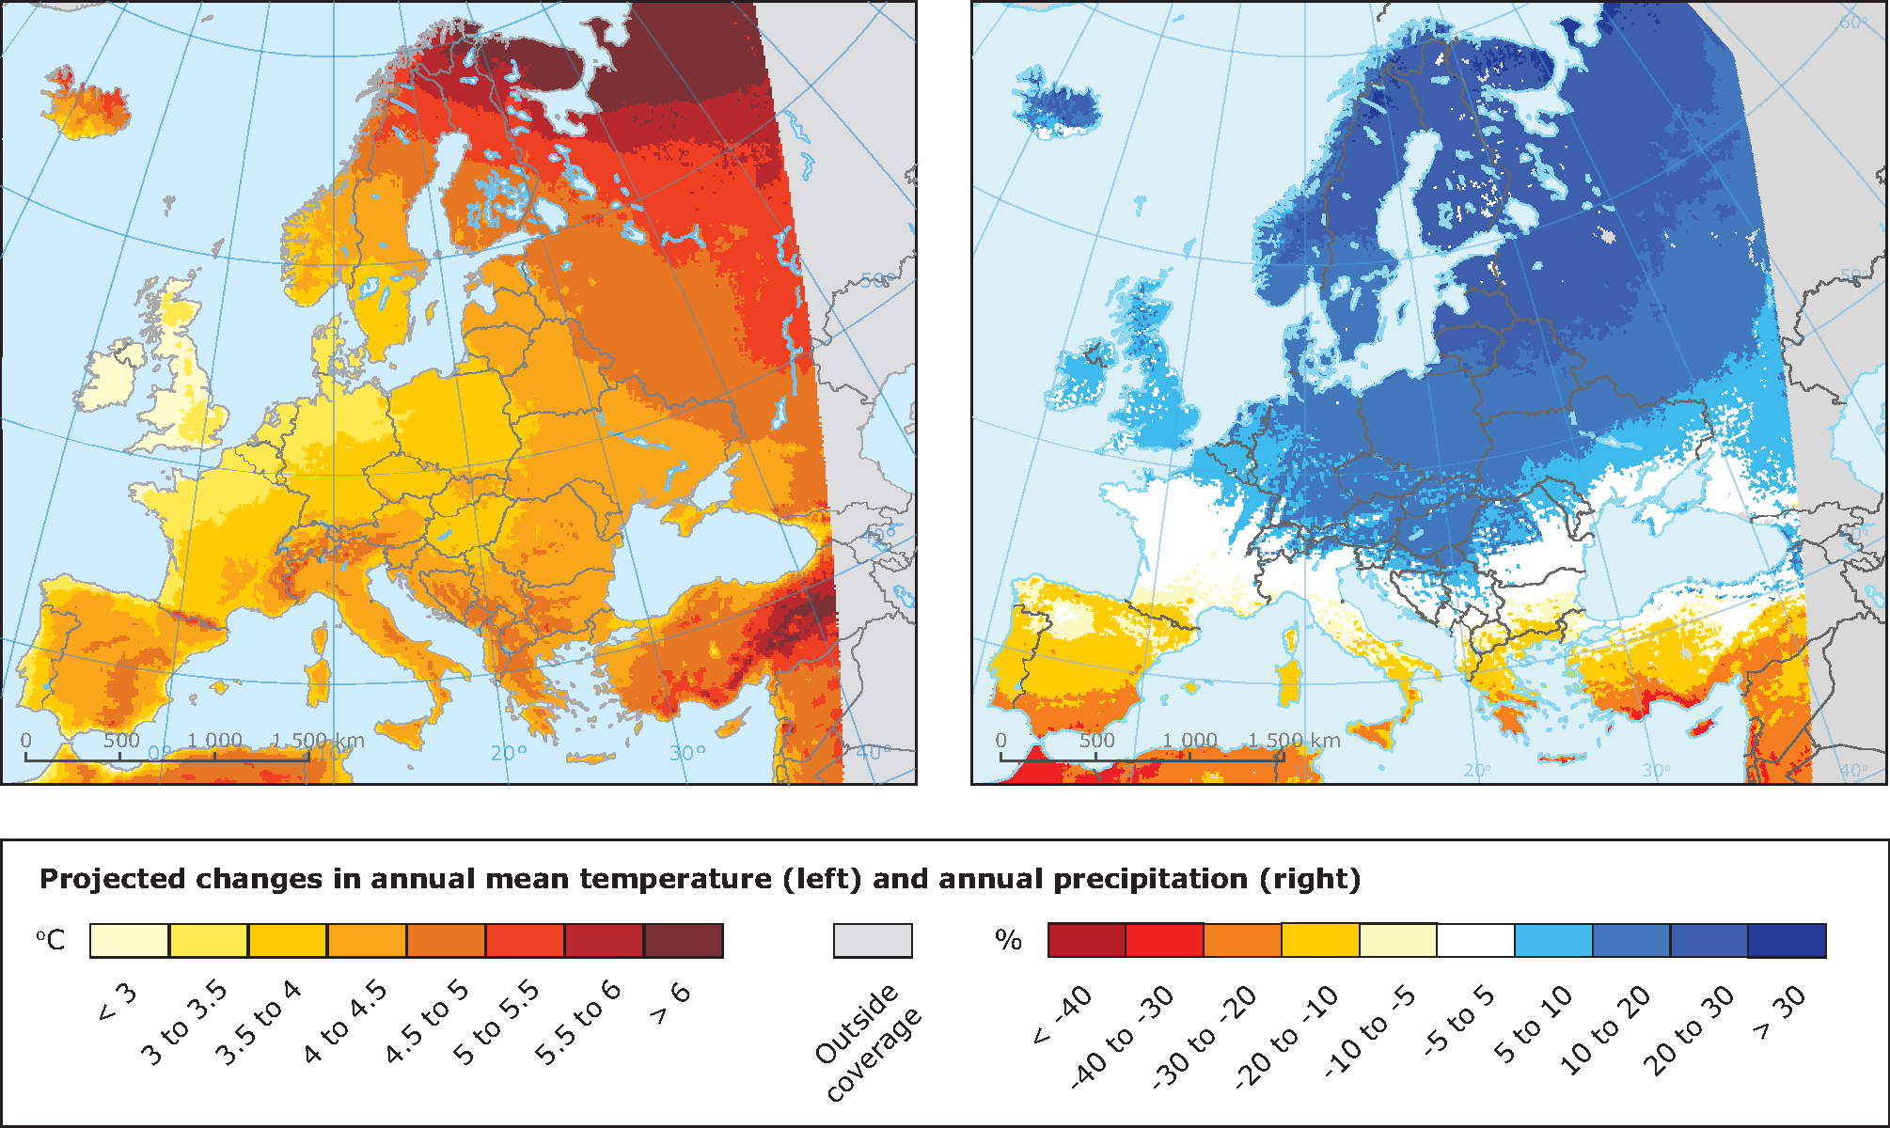
What is climate change?
Climate change can be a natural process where temperature, rainfall, wind and other elements vary over decades or more. In millions of years, our world has been warmer and colder than it is now. But today we are experiencing unprecedented rapid warming from human activities, primarily due to burning fossil fuels that generate greenhouse gas emissions.
4

Slide 5
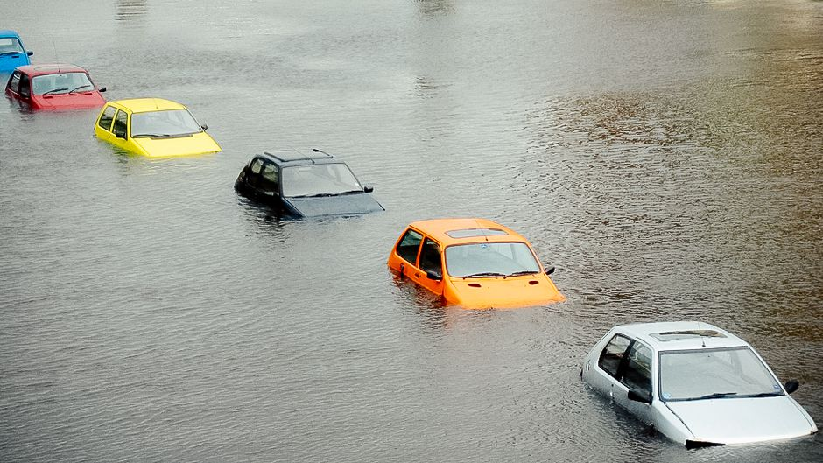
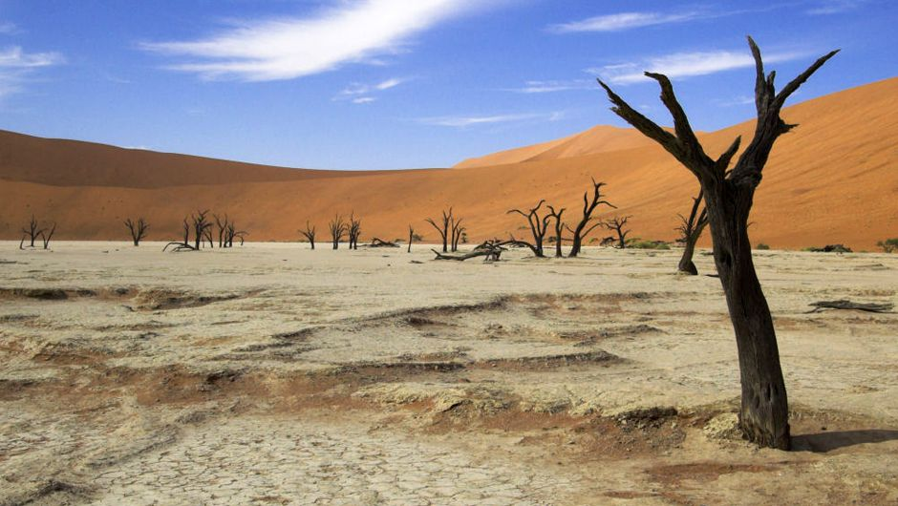
The Effects of Climate Change
The effects of climate change can be different. It could flood or make a drought.
4
5
This Photo by Unknown Author is licensed under CC BY-NC
This Photo by Unknown Author is licensed under CC BY-SA-NC

Slide 6
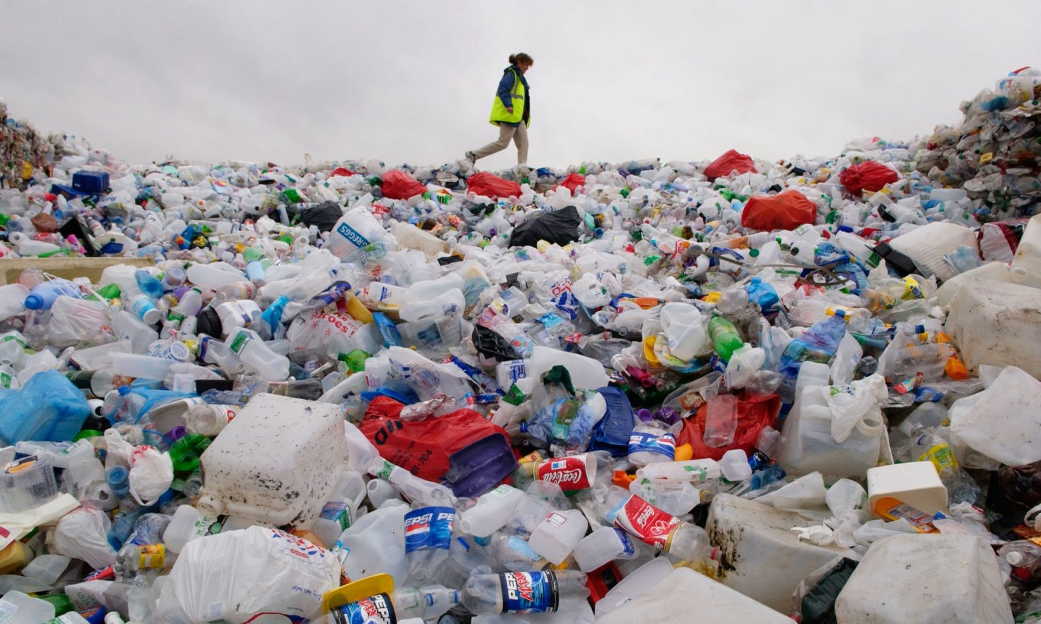
What can we do to help?
We can do lots of things to help like:
planting trees
go litter picking
cut down less trees and rainforest
stop littering
use less water
don’t drive if you don’t need to
Reduce food waste
But we cant do It by ourselves
6
This Photo by Unknown Author is licensed under CC BY-NC

Slide 7
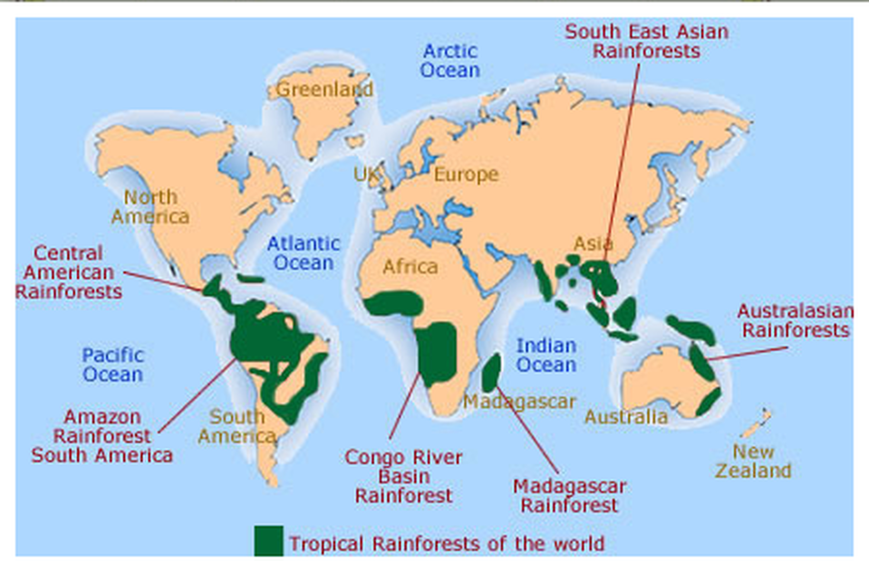
The rainforests
Most of the rainforests are being chopped down. And more and more animals are dying because of the trees and we are having less oxygen because of less trees in the rainforests.
Did you know
Scientist even believe that there is still animals to be discovered.
7

Slide 8
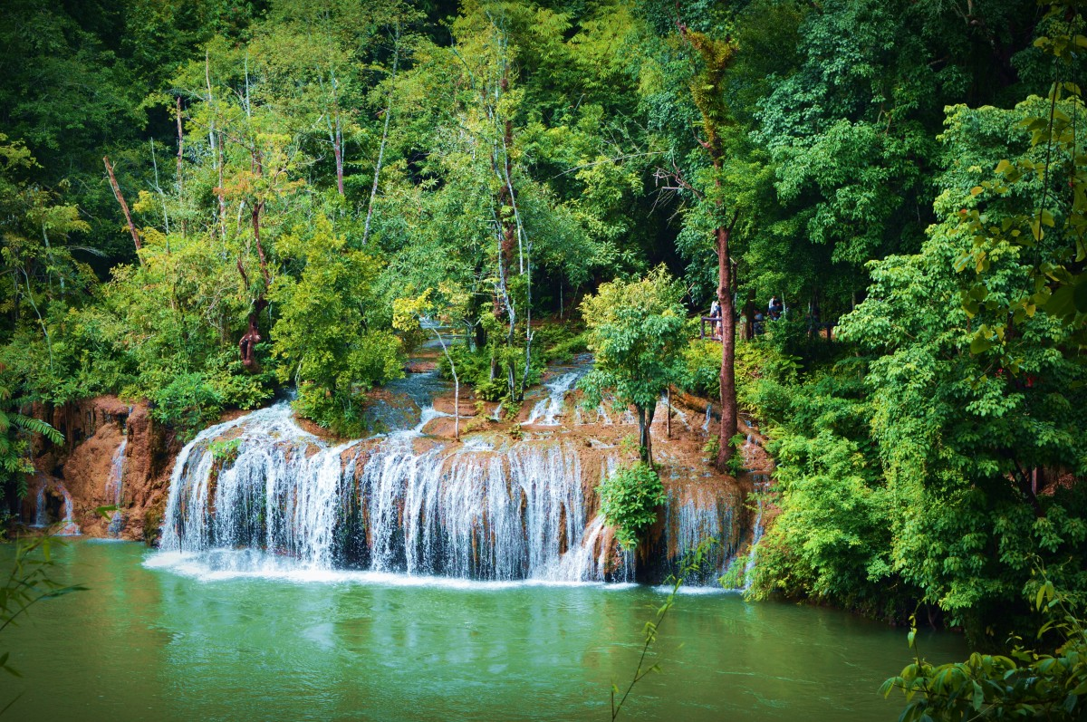
8

Slide 9
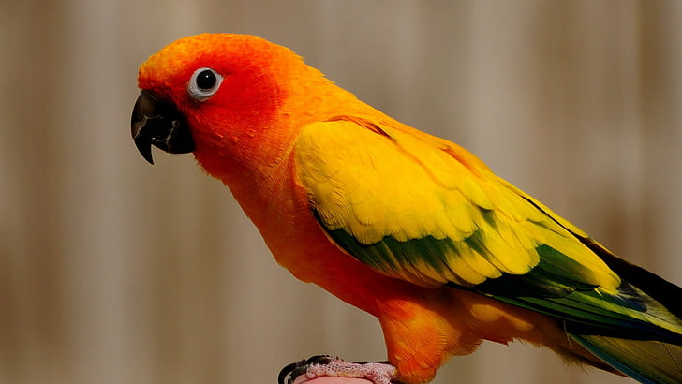
This book is about helping the world and keeping people and animals alive.
IF WE WORK TOGETHER WE CAN MAKE A HUGE DIFFERENCE TO THE WORLD.

